Slide 1
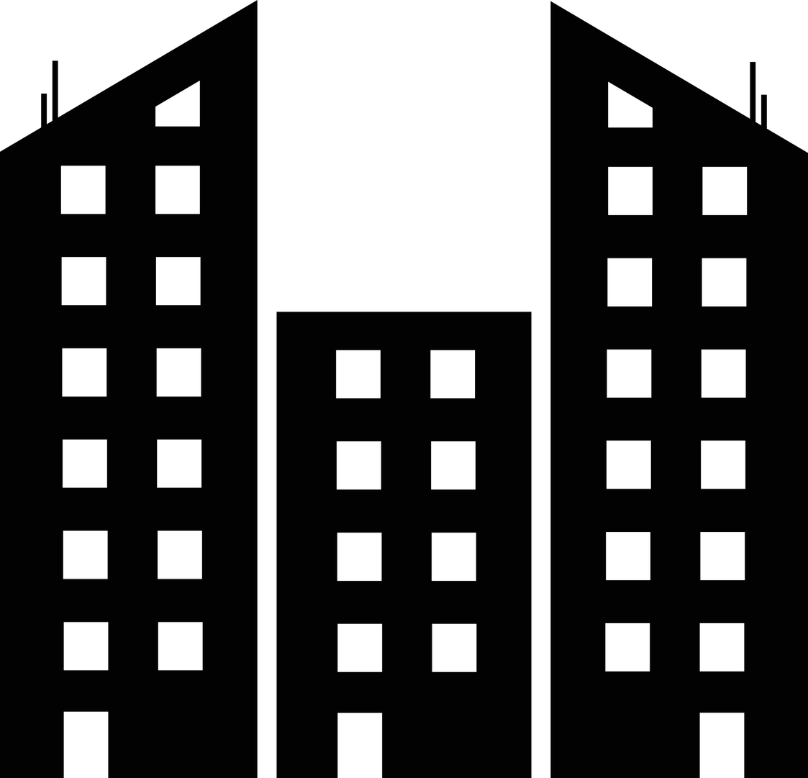

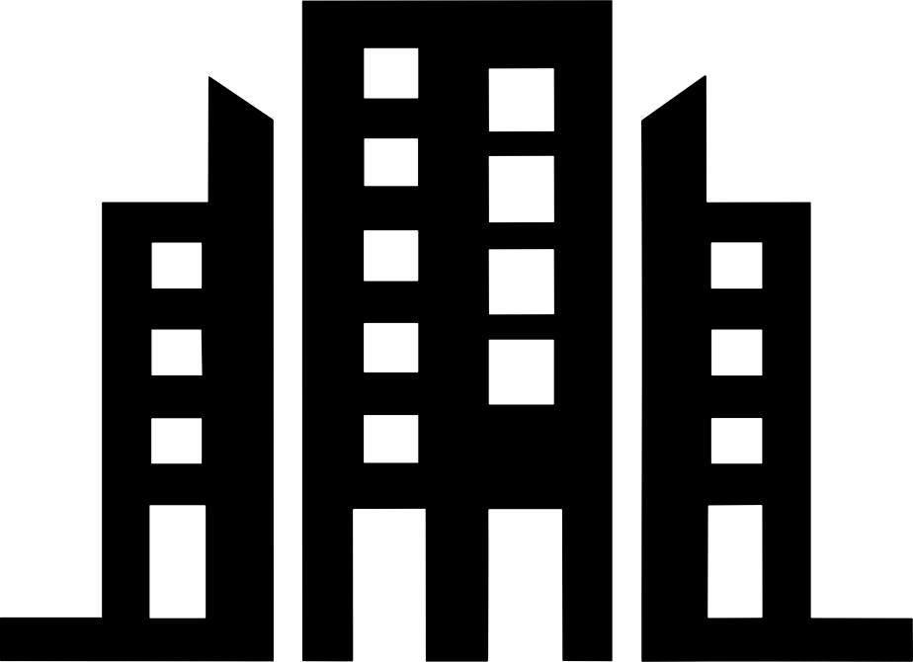

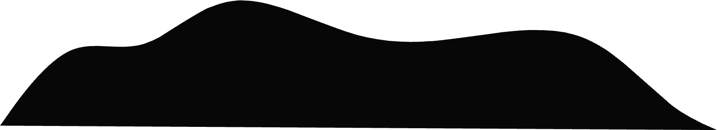
CS 440 Group 4 - Design Project
SubterraView
SubterraView
MAPPING THE UNDERGROUND WORLD
Ashton EdakkunnAthu, Jay Patel, Manan Patel, Lena Tran
Notes:
This is SubterraView

Slide 2
1
PROJECT REFRESHER
2
Notes:
Alright, we will start off the presentation with a refresher on what SubterraView is.

Slide 3
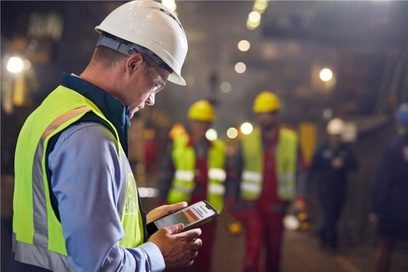

SubterraView Overview
Real-time AR map of underground infrastructure accessible from any smartphone
Instant hazard alerts for gas leaks, structural instabilities, etc.
Field workers can report and update infrastructure directly from the field
≥ 30% reduction in accidental utility strikes vs. national average
3
Notes:
SubterraView is an AR and AI powered smartphone app that gives construction workers, utility crews, and emergency responders a real time view of what's underground. Instead of waiting days for 811 markings that may not even be accurate, workers can point their phone at the ground and instantly see verified utility lines and infrastructure. We're not replacing 811, we're the tool that keeps workers informed and safe between those steps.

Slide 4

Requirements
Functional Requirements
AR Visualization Display
Hazard Alert Detection
Non-Functional Requirements
Performance
Reliability
4
Notes:
SubterraView has functional and non-functional requirements.
On the functional side, two that stand out are AR Display and Hazard Detection — the AR display is literally what the user is looking at on their screen, and hazard detection makes sure they're notified the moment something dangerous is nearby.
On the non-functional side, the two big ones are performance and reliability. Performance matters because the AR overlay needs to render in real time as the worker moves — we want everything to be in-sync. And reliability is critical because if the AI engine goes down or returns bad data, the worker has no idea what they're actually looking at. So we need to meet these requirements.

Slide 5
2
SYSTEM ARCHITECTURE
5
Notes:
Now let's move on to the overall structure of subterraview.

Slide 6
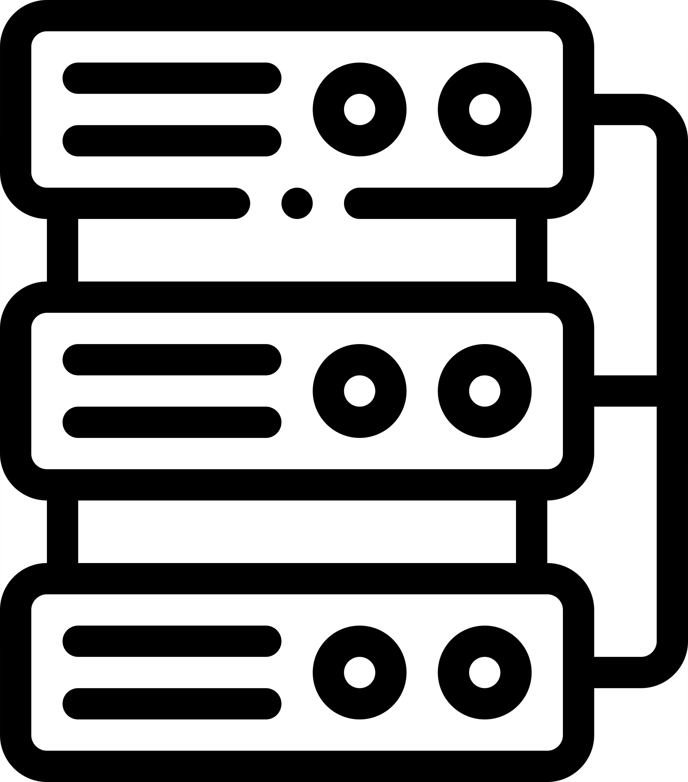

MVC
Model
View
Infrastructure Database
Infrastructure Record
HazardAlert
FieldReport
CrowdsourcedReport
SubterraViewApp
AROverlay
Controller
ValidationEngine
HazardMonitoringSystem
End User
6
Notes:
SubterraView uses MVC to keep the data, logic, and interface separated.
The Model consists of Alerts, Records, and Reports, which are data objects that represent the state of the system at any given time.
Using a database system, the model reads from the InfrastructureDatabase, which is a persisitent storage layer.
The View is the app and AR visualization component.
The Controller consists of the ValidationEngine and HazardMonitoringSystem.
The ValidationEngine cross-references infrastructure records, assigns confidence ratings, and flags anything below the quality threshold for administrator review.
The HazardMonitoringSystem processes real time sensor readings and generates alerts when dangerous conditions are detected.
We chose MVC because SubterraView has many parts that need to evolve independently, so MVC ensures future developers can update any one of them without affecting the others.

Slide 7
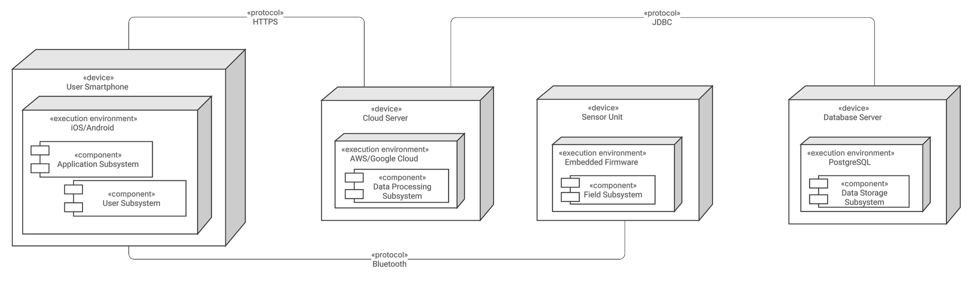
Client-Server
7
Notes:
SubterraView also follows a Client-Server architecture across four physical devices. The User Smartphone is the primary client, communicating with the Cloud Server over HTTPS where all the validation and hazard monitoring logic runs. The Sensor Unit acts as a second client, sending readings to the smartphone which forwards them up to the cloud for processing. The Cloud Server then connects to the Database Server over JDBC where all persistent data is stored. We chose Client-Server because the system depends on multiple physical devices staying in sync.

Slide 8
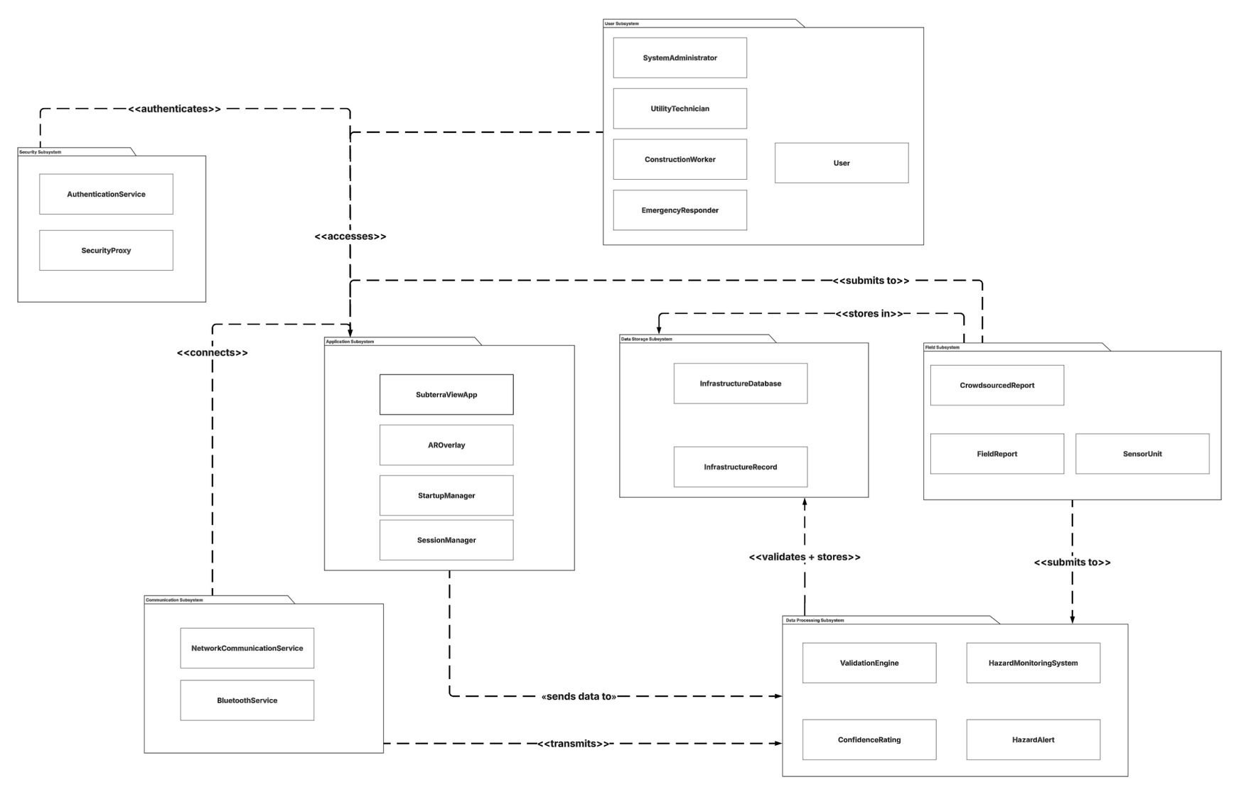
Subsystems Overview
1
2
1 - User
2 - Security
3 - Application
4 - Field
5 - Data Storage
6 - Communication
7 - Data Processing
3
4
5
6
7
8
Notes:
SubterraView is organized into seven subsystems. For example, when a construction worker opens the app, their request moves through the User and Security subsystems, gets validated by Data Processing, and the result is rendered back through the Application Subsystem in real time. The Field, Data Storage, and Communication subsystems work behind the scenes to collect, store, and transfer the data that makes all of this possible.

Slide 9
3
SYSTEM DESIGN
9

Slide 10
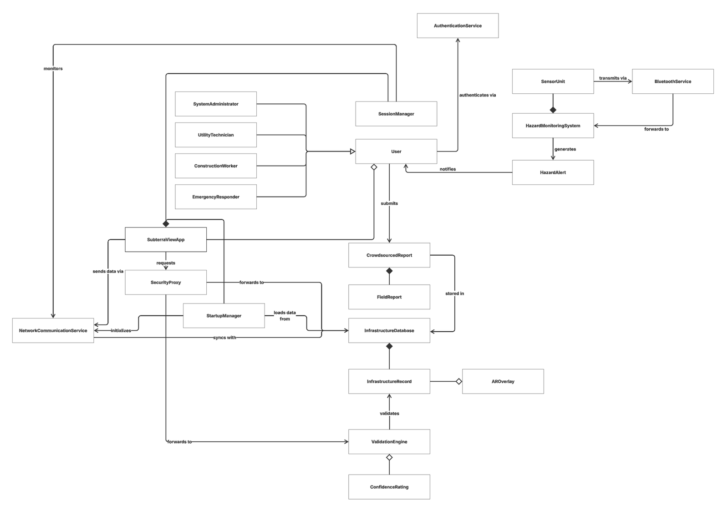
Classes
Groups:
Users
Main Application
Data Handling Pipeline
Hazard Monitoring System
10
Notes:
Alright, so this is our class diagram.
… jargon …
On a high level, the system is organized into few key groups, users, the main application, data handling pipeline and a hazard monitoring system.
Starting with the users, there’s one user main class that contains information like name, email, and password. Then there’s other subclasses like construction workers, emergency responders, and administrators that inherit the main user class.
Then we have the main subterraview app, that handles things like the session, startup behavior, and AR overlay.
As I mentioned above, there’s also a data handling pipeline that not only stores data but also validates data like user submitted reports. This is also connected to the hazard monitoring system that analyzes incoming data for potential hazards.

Slide 11
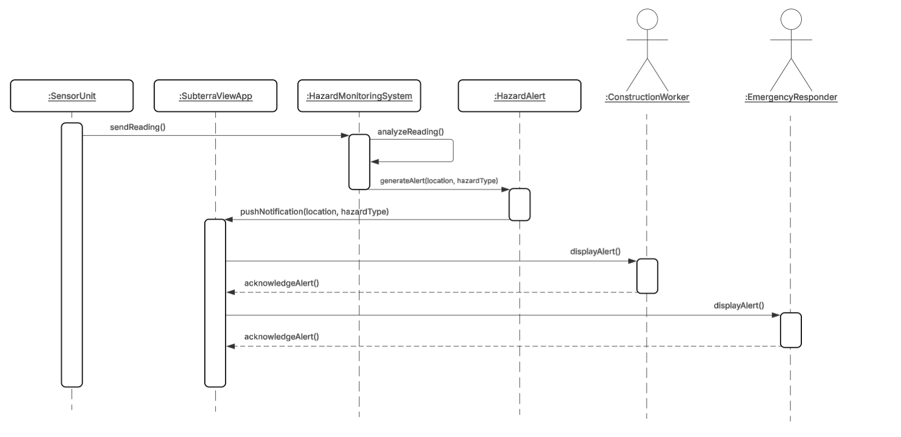
UC-4: Recieve Data Alert
11
Notes:
Now that I explained the classes, let’s take a closer look at one of our use cases that involves some of these classes. So this sequence diagram shows how the system handles hazard alerts in real time.
Unlike most use cases, this one is not initiated by a user. So imagine you’re just a construction worker on site doing your normal work.
In the background, sensor units are constantly running, monitoring conditions like gas levels. Now say one of the sensors picks up abnormal readings, those readings are then automatically sent to the hazard monitoring system which analyzes the information and determines if it really is a hazard.
If it is, then it’ll send a message to the main application and the main application will inform the workers via alerts on the ui with vibrations to really get their attention. On top of that, the application will inform the emergency responders who can act on the situation in a timely manner.
So this whole autonomous hazard detection system can be the difference between early intervention and serious harm.

Slide 12
4
OBJECT DESIGN
12

Slide 13
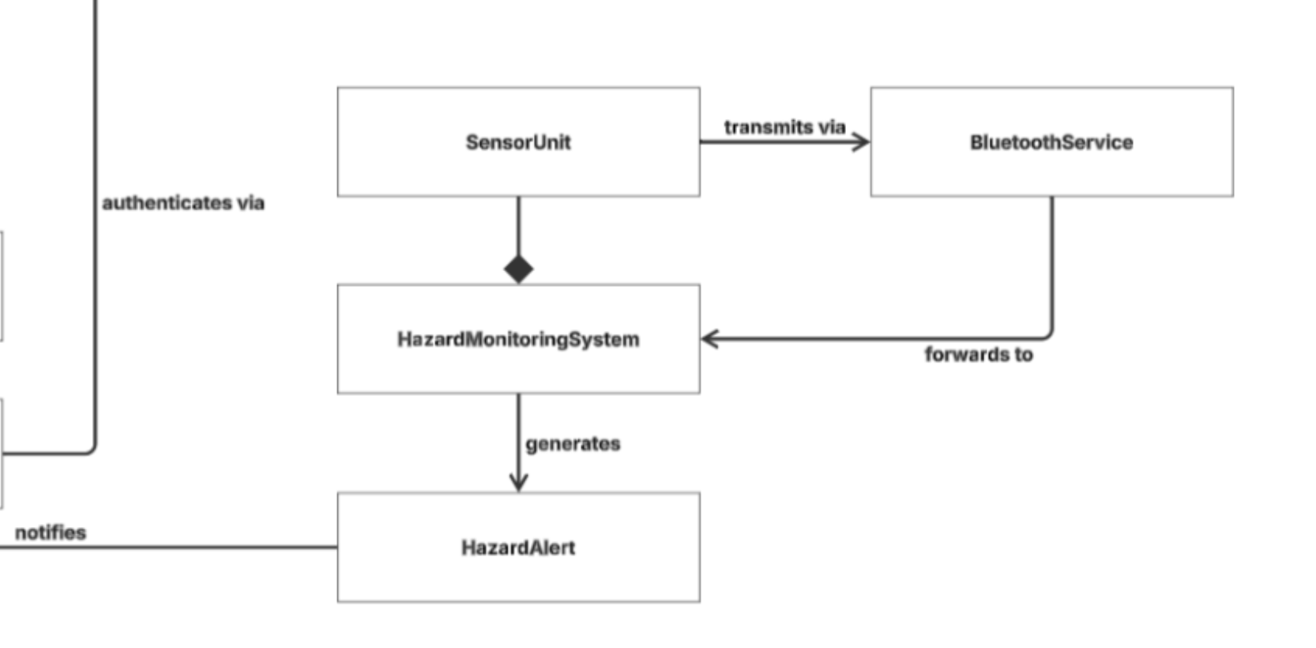
UC-4 Continued
13
Notes:
Still on Use Case 4 — this is the object design behind it.
So the Observer pattern has two key roles — a subject and its observers. In our case, HazardMonitoringSystem is the subject. It's the one with the information — it knows when a hazard is detected. The observers are the components that need to react to that — the construction worker, the emergency responder.
The reason we chose Observer here is because hazard detection is a one-to-many problem. One system detects, but multiple parties need to react. Without Observer, we'd have to modify the class every time for a new person.

Slide 14
Example Code – For Next Group
public class HazardMonitoringSystem {
private List<SensorUnit> activeSensors;
private double alertThreshold;
private List<Observer> observers;
public void receiveReading(SensorUnit sensor, double reading)
public void analyzeReading(double reading)
public HazardAlert generateAlert(String location, String hazardType)
public void registerObserver(Observer observer)
public void removeObserver(Observer observer)
public void notifyObservers(HazardAlert alert)
}
14
Notes:
Here's an example of what the HazardMonitoringSystem class actually looks like in code. This is a working implementation — the attributes, the methods, all of it should be compatible with the rest of the system.
The three underlined methods at the bottom is our Observer pattern. Any component that needs to be notified of a hazard gets registered, and when one hazard is detected notifyObservers send alters to everyone. Everything else in the class is supporting that core responsibility.

Slide 15
5
CONCLUSION
15
Notes:
Lena:
To begin, we are going to explore what SubterraView actually is.

Slide 16

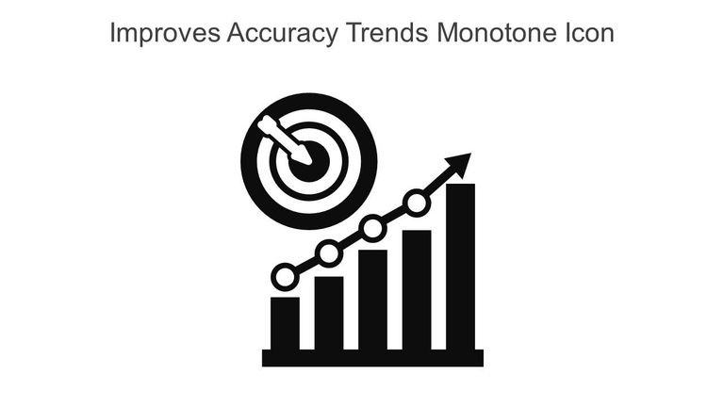
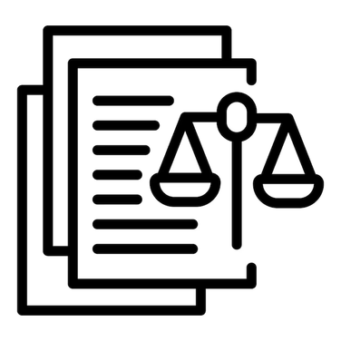
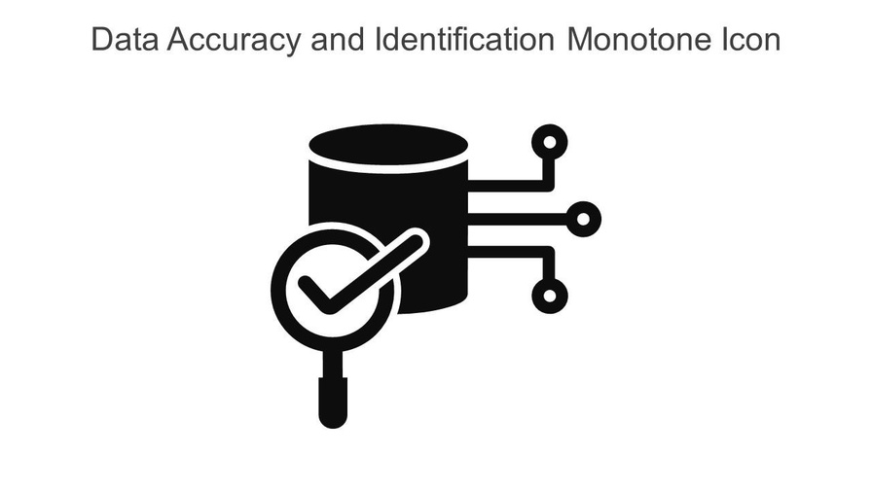
Open Issues
Access to accurate utility data
Data Standardization
AR Inaccuracies
Legal Liabilty
Crowdsourcing Validation
16
Notes:
Access to accurate utility data is our most pressing open issue — it's currently unknown whether all utility companies and municipal agencies will provide consistent, real-time access to underground utility data, with privacy restrictions and outdated records being the primary barriers
Data standardization remains unfinalized — every agency stores infrastructure data in different formats, meaning a custom integration would be needed for each unique source, adding significant complexity to our AI validation pipeline
AR inaccuracies are still an unknown — the effectiveness of our overlay hasn't been fully tested across real field conditions like harsh lighting, bad weather, or physical obstructions, and structured field trials will be needed to quantify performance
Legal liability around underground data sharing remains fluid — potential regulatory changes could shift how data is accessed and who bears responsibility
Crowdsourcing validation carries similar legal unknowns — questions around data ownership and liability in a crowdsourced model have not yet been resolved

Slide 17
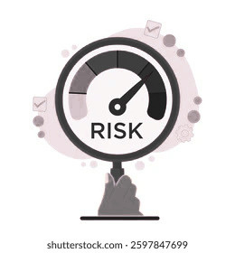
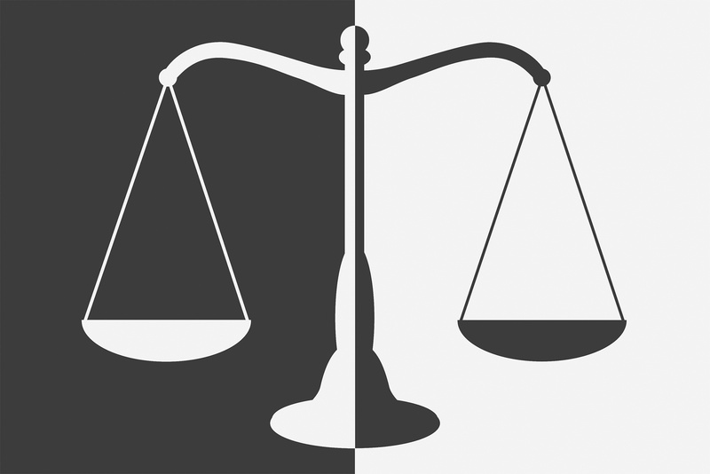
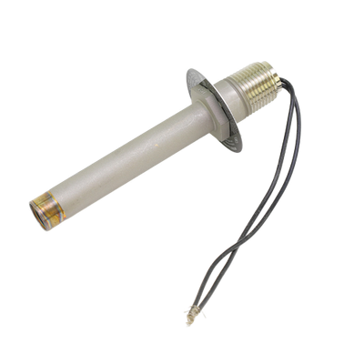
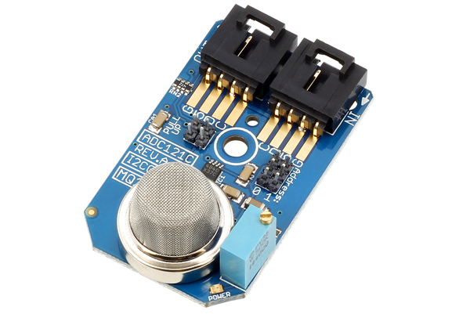
Risks
Inaccurate data
Senor malfunctions
Legal leeway
17
Notes:
Inaccurate or incomplete infrastructure data is rated High Probability, High Impact — this is our most critical risk and directly ties back to the data access issues just discussed
Integration failures with external systems are rated Medium Probability, High Impact — dependencies on third-party systems introduce points of failure that need redundancy planning
Sensor hardware malfunction is rated Medium Probability, High Impact — calibration protocols and hardware redundancy will be essential to keeping data reliable in the field
Legal and regulatory challenges are rated Low Probability but High Impact — while unlikely in the near term, a significant regulatory shift could meaningfully affect our data sharing model

Slide 18
Thank You
FOR LISTENING =)

